Slide 1

Presentation on software testing for test scenario and test case design Name : S . Towhid Hussain reg no : 192111049 Dept : CSE Course code : CSA3724 Course name : Software testing for debugging

Slide 2
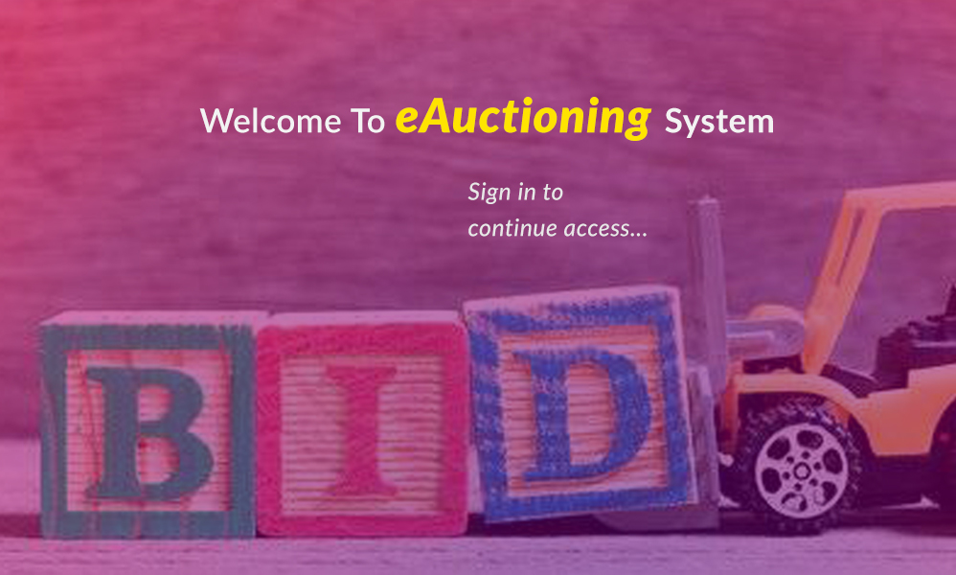

Slide 3
Aim:
To identify and analyze the requirements for the login model of e-auction and find the positive and negative test scenarios and test cases.

Slide 4
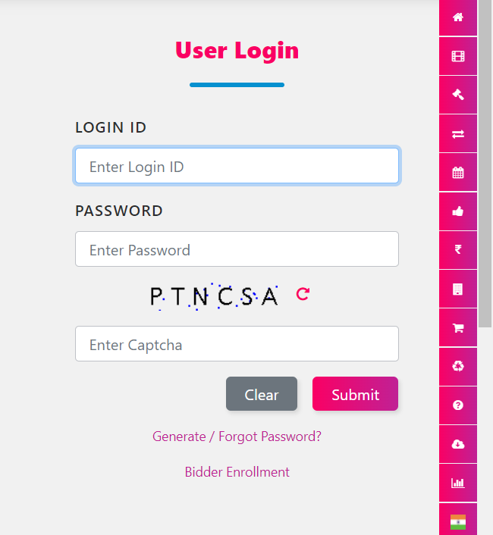
Login page :

Slide 5
Requirements :
USER NAME
PASSWORD
LOGIN ID
EMAIL ID
MOBILE NUMBER

Slide 6
POSITIVE TEST SCENARIO :
Verify if a user will be able to login with a valid username and valid password
Verify the “forgot password” functionalities
Verify the messages for invalid login
Verify “ remember me “ functionality
Verify if the data in password field is either visible as asterisk or bullet signs
Verify if a user is able to login with a new password only after he/she has changed the password .
Verify if the login page allows to login simultaneously with different credentials in a different browser
Verify if enter key of the keyboard is working correctly on the login page
Verify the time taken to login with a valid username and password
Verify the time out functionality of login session

Slide 7
Negative test scenario :
Verify if a user cannot login with a valid username and invalid password
Verify if a user cannot login with a invalid username and valid password
Verify the login page for username is blank and login button is clicked
Verify the login page for password is blank and login button is clicked
Verify if a user cannot enter the character more than the specified range in each field(username and password)
Verify the login page by pressing back button of the browser . It should not allow yo9u to enter into the system once you log out
Verify if a user should not be allowed to login with different credentials from the same browser at the same time
Verify the login page against SQL injection attack
Verify if the user cannot login with out invalid OTP
Verify if user cannot find the account with forgot password button

Slide 8
Test cases :
Validate user login if successfully credentials entered - PASS
Validate if user is not allowed to access when credentials are incorrect - PASS
Validate if user can login through phone number and OTP - PASS
Validate if user can login through skin and access - PASS
Validate if user can create account through phone number and OTP verification - PASS

Slide 9
Validate if forgot password is used for recovery of account - FAIL
Verify if both , fields left blank and click submit - FAIL
Validate if both user id and password are invalid - FAIL
Validate if new registration entered a valid phone number/email id - FAIL
Validate if new user can register through any existing password - FAIL

Slide 10
Conclusion :
I have navigate the e-auction india application and find out the positive and negative test scenarios and test cases . This is to improve the performance of the application in better manner

Slide 11


